Slide 1

Operations Strategy
CORE CURRICULUM
This PowerPoint presentation was prepared by Marco Iansiti, David Sarnoff Professor of Business Administration, Harvard Business School, and Alain Serels, HBS Research Associate, for the purpose of aiding classroom instructors in using Core Reading: Operations Strategy (HBP No. 8000). HBP Core Readings are developed solely as the basis for class discussion. They are not Intended to serve as endorsements, sources of primary data, or illustrations of effective or ineffective management. PowerPoint® is a registered trademark of Microsoft Corporation.
Copyright © 2013, 2024 Harvard Business School Publishing Corporation. All rights reserved.
HBP# 8006

Slide 2
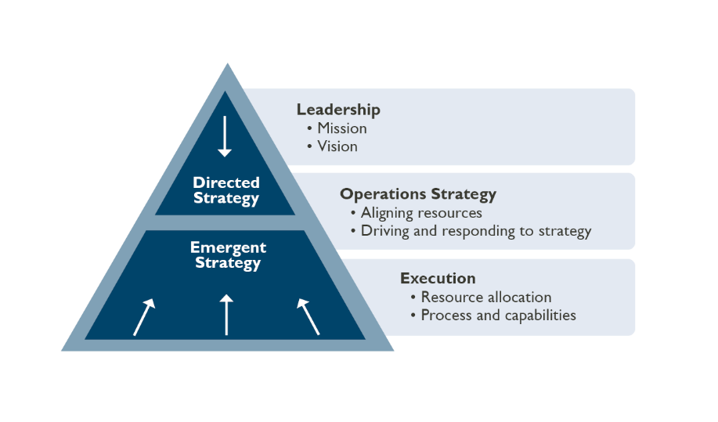
Operations Strategy Connects Directed and Emergent Strategies
CORE CURRICULUM
Marco Iansiti and Alain Serels, Core Reading: Operations Strategy, HBP No. 8000 (Boston: Harvard Business School Publishing, 2013, 2024). © Copying or posting is an infringement of copyright.

Slide 3
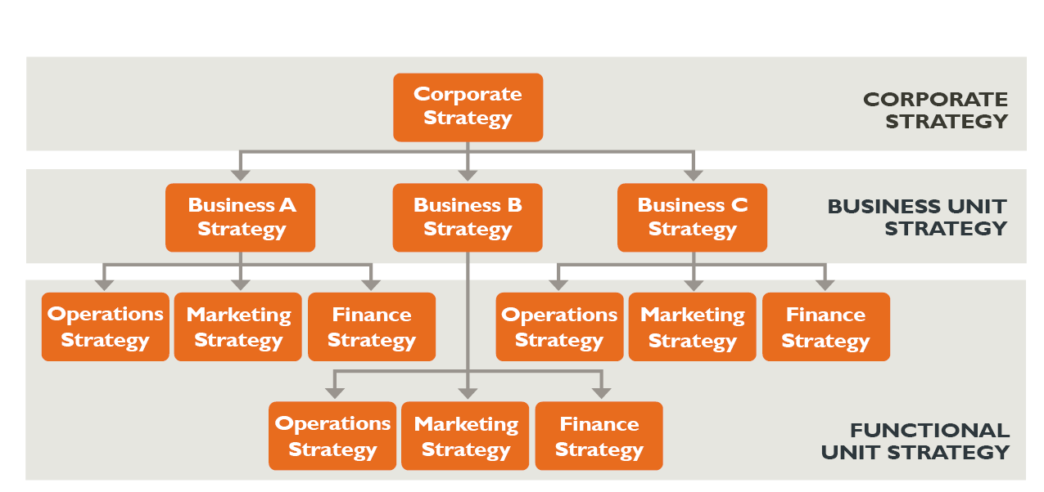
Strategy Hierarchy
CORE CURRICULUM
Source: Reprinted and adapted by permission from Robert H. Hayes and Steven C. Wheelwright, Restoring Our Competitive Edge: Competing Through Manufacturing (New York: John Wiley & Sons, 1984), p. 28. Copyright © 1984 by John Wiley & Sons
Marco Iansiti and Alain Serels, Core Reading: Operations Strategy, HBP No. 8000 (Boston: Harvard Business School Publishing, 2013, 2024). © Copying or posting is an infringement of copyright.

Slide 4
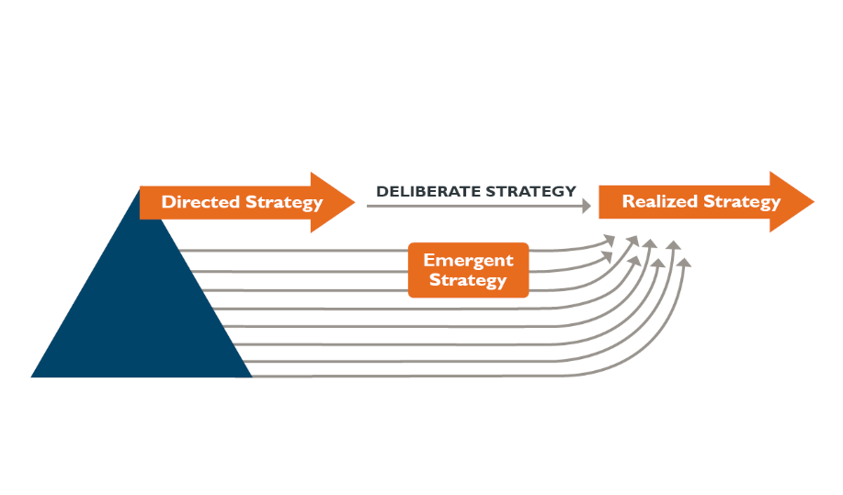
Directed and Emergent Strategies
CORE CURRICULUM
Source: Adapted with permission from Henry Mintzberg, “Patterns in Strategy Formation,” Management Science 24, no. 9 (1978): 945. Copyright © 1978, the Institute for Operations Research and the Management Sciences, 7240 Parkway Drive, Suite 300, Hanover, Maryland 21076.
Marco Iansiti and Alain Serels, Core Reading: Operations Strategy, HBP No. 8000 (Boston: Harvard Business School Publishing, 2013, 2024). © Copying or posting is an infringement of copyright.

Slide 5
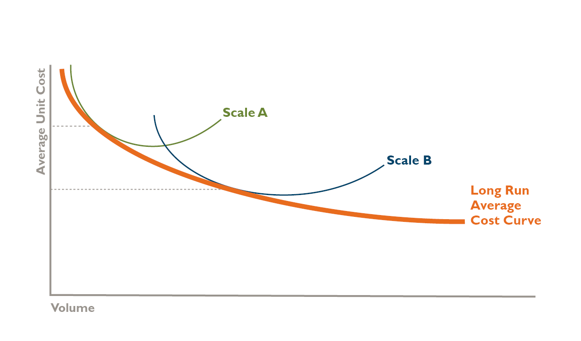
Economies of Scale
CORE CURRICULUM
Marco Iansiti and Alain Serels, Core Reading: Operations Strategy, HBP No. 8000 (Boston: Harvard Business School Publishing, 2013, 2024). © Copying or posting is an infringement of copyright.

Slide 6
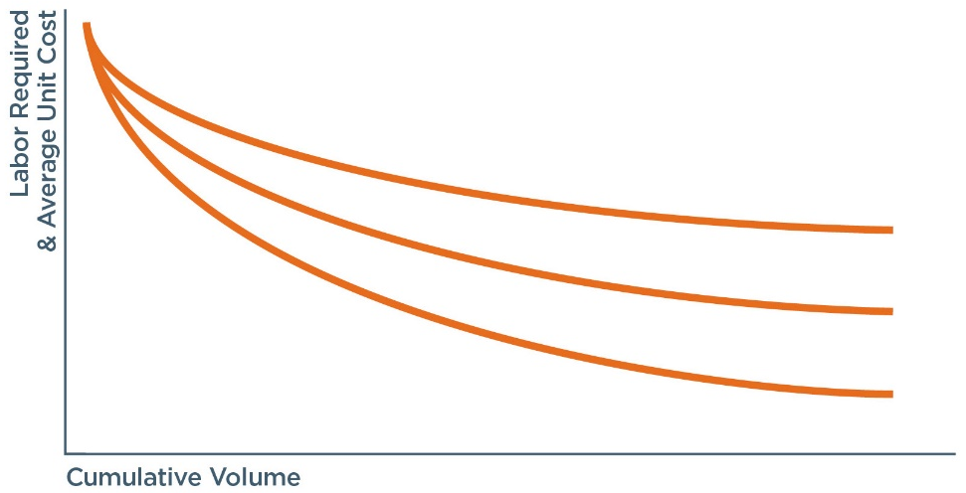
Learning Curve
CORE CURRICULUM
Source: Based on learning curve concept developed by T. P. Wright, "Factors Affecting the Cost of Airplanes," Journal of Aeronautical Sciences 3(4) (1936): 122–128 and extended in Bruce Henderson, “The Experience Curve,” BCG Perspectives, Boston Consulting Group, 1968
Marco Iansiti and Alain Serels, Core Reading: Operations Strategy, HBP No. 8000 (Boston: Harvard Business School Publishing, 2013, 2024). © Copying or posting is an infringement of copyright.

Slide 7
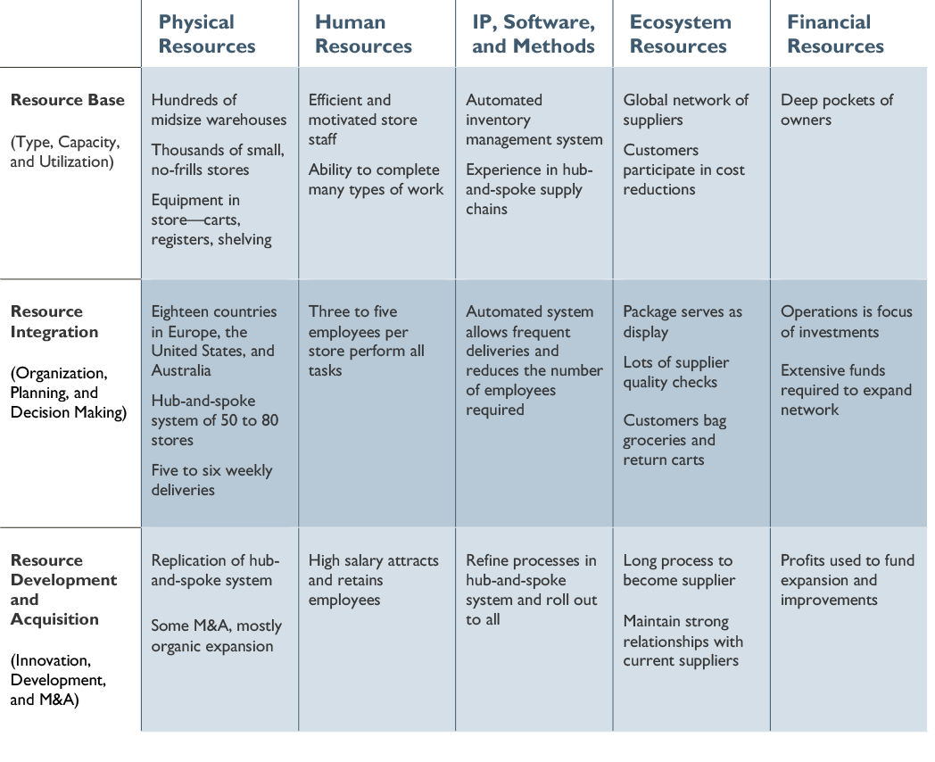
Aldi’s Resource-Based Operations Strategy Matrix (2012)
CORE CURRICULUM
Source: Adapted from Marc Sachon, “Aldi: Disruptor Disrupted?” Case IES944 (Barcelona: IESE Publishing, 2023). Adapted by permission of Harvard Business Review from Jan-Benedict Steenkamp and Nirmalya Kumar, "Don't Be Undersold!," Harvard Business Review 87, no. 12 (2009). © 2009 by the Harvard Business School Publishing; all rights reserved.
Marco Iansiti and Alain Serels, Core Reading: Operations Strategy, HBP No. 8000 (Boston: Harvard Business School Publishing, 2013, 2024). © Copying or posting is an infringement of copyright.

Slide 8
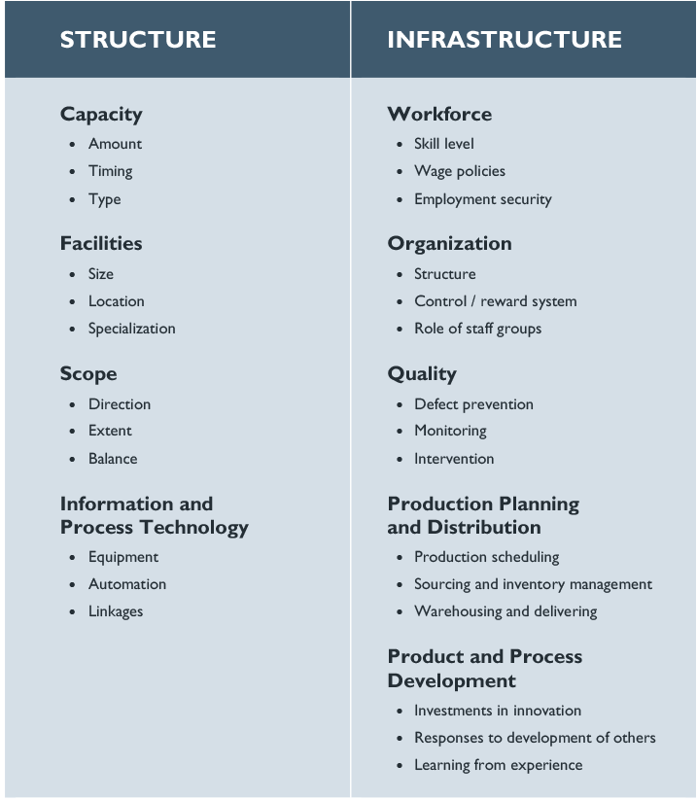
Operations Decision Areas
CORE CURRICULUM
Source: Adapted from Steven Wheelwright, “Japan—Where Operations Really Are Strategic,” Harvard Business Review 59, no. 4, (1981): 68.
Marco Iansiti and Alain Serels, Core Reading: Operations Strategy, HBP No. 8000 (Boston: Harvard Business School Publishing, 2013, 2024). © Copying or posting is an infringement of copyright.

Slide 9
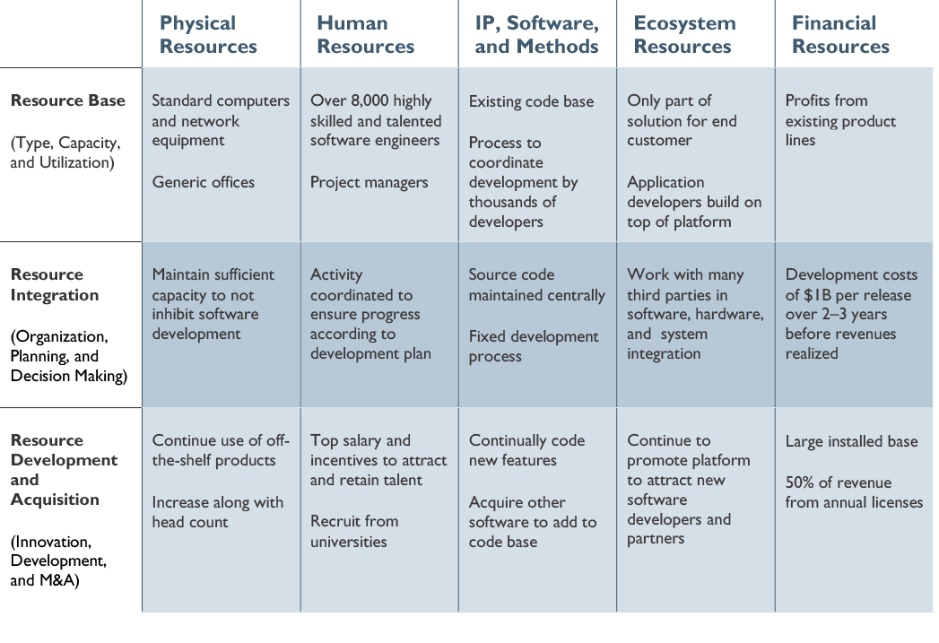
Microsoft STB’s Traditional Operations Strategy
CORE CURRICULUM
Source: Adapted from Marco Iansiti and Alain Serels, “Microsoft Server & Tools,” HBS No. 613-031 (Boston: Harvard Business School, 2013).
Marco Iansiti and Alain Serels, Core Reading: Operations Strategy, HBP No. 8000 (Boston: Harvard Business School Publishing, 2013, 2024). © Copying or posting is an infringement of copyright.

Slide 10
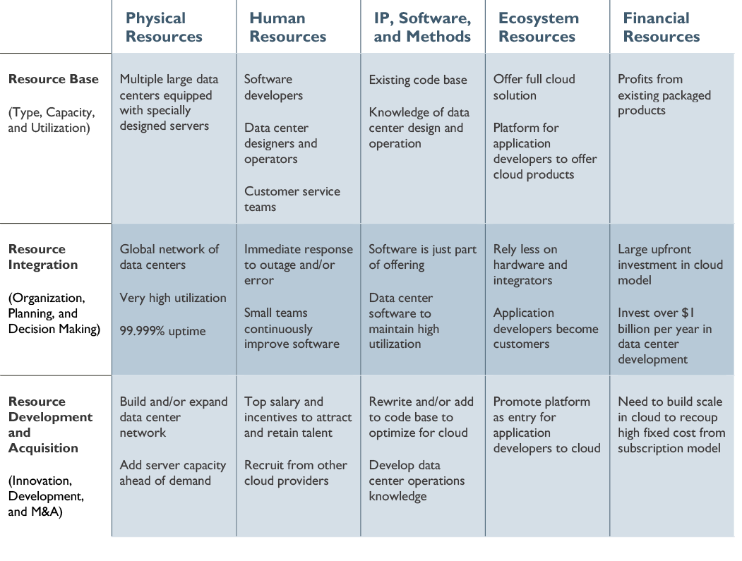
Microsoft STB’s Cloud Operations Strategy (2013)
CORE CURRICULUM
Source: Adapted from Marco Iansiti and Alain Serels, “Microsoft Server & Tools,” HBS No. 613-031 (Boston: Harvard Business School, 2013).
Marco Iansiti and Alain Serels, Core Reading: Operations Strategy, HBP No. 8000 (Boston: Harvard Business School Publishing, 2013, 2024). © Copying or posting is an infringement of copyright.

